Slide 1
Advance Database Management System (ADBMS)
Sub-Code: 24-CSP-310, 24-CSP-333
ALOK KUMAR – ASSISTANT PROFESSOR & KARGIL TECHINCAL TRAINER (DCPD)
EMAIL: DCPD.KARGILT1@CUMAIL.IN

Slide 2
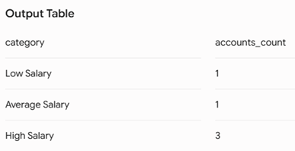
Experiment 01
(A)
Write an SQL solution to calculate the total number of bank accounts belonging to each salary category. The classification categories are:
"Low Salary": All monthly salaries strictly less than $20,000.
"Average Salary": All monthly salaries in the inclusive range [$20,000, $50,000].
"High Salary": All monthly salaries strictly greater than $50,000. The final result table must report all three categories, even if a category contains zero accounts.

Slide 3
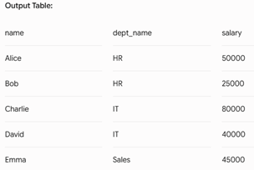
Experiment 01
(B)
Design an Employee Management System database architecture by implementing the following operations sequentially:
Create and populate structural tracking tables for Departments, Employees, and Salaries.
Query the system using multi-table Joins to pull clear department breakdowns, apply a 10% salary enhancement across all members of the HR department, and delete any individual salary record dropping strictly below $30,000.
List all remaining active employees whose personal salary exceeds the overall company-wide average salary.

Slide 4
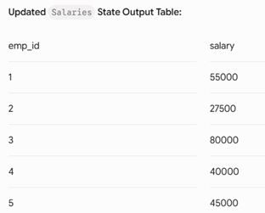
Experiment 01
(B)
Design an Employee Management System database architecture by implementing the following operations sequentially:
Create and populate structural tracking tables for Departments, Employees, and Salaries.
Query the system using multi-table Joins to pull clear department breakdowns, apply a 10% salary enhancement across all members of the HR department, and delete any individual salary record dropping strictly below $30,000.
List all remaining active employees whose personal salary exceeds the overall company-wide average salary.
Part B: Apply 10% HR increase using IN subquery filtering

Slide 5
Experiment 01
(Amazon)
(C)
A pizza restaurant stores all the available pizza toppings and their ingredient costs in a table called pizza_toppings.
Every customer must choose exactly 3 different toppings to prepare a pizza.
Write a PostgreSQL query to generate every possible 3-topping pizza combination along with its total ingredient cost.
Requirements
Every pizza must contain exactly 3 different toppings.
The same topping cannot appear more than once in a pizza.
Different arrangements of the same toppings should be considered the same pizza.
  Example:
    Chicken, Pepperoni, Sausage
    Pepperoni, Chicken, Sausage
    Sausage, Chicken, Pepperoni
  These are all the same pizza, so only one should appear.
Display the topping names separated by commas.
Display the total ingredient cost of each pizza.
Sort the output:
  First by highest total cost
  If two pizzas have the same cost, sort them alphabetically.

Slide 6
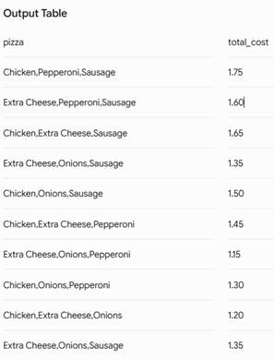

Slide 7
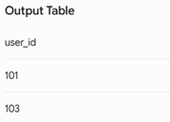
Experiment 01
(D)
Amazon wants to identify returning customers who made another purchase shortly after their first purchase.
Write a PostgreSQL query to find all users who made another purchase within 1 to 7 days of an earlier purchase.
Requirements
Compare purchases made by the same user only.
Ignore comparisons where the same transaction is matched with itself.
The second purchase must occur after the first purchase.
Same-day purchases must not be considered.
The second purchase must occur within 7 days of the first purchase.
Display only the unique User IDs that satisfy the above conditions.
Sort the output in ascending order of user_id.

